Slide 1
FEMM SIMULATIONS

Slide 2
Cupper coil at 10 AWG, 500 Amperes
Pure iron core

Slide 3
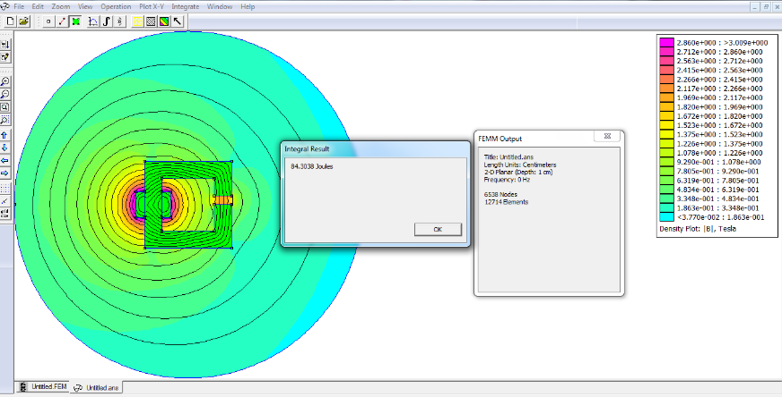

Slide 4
System energy (coil+core) = 84.3038 Joules
Core energy = 35.4898 Joules

Slide 5
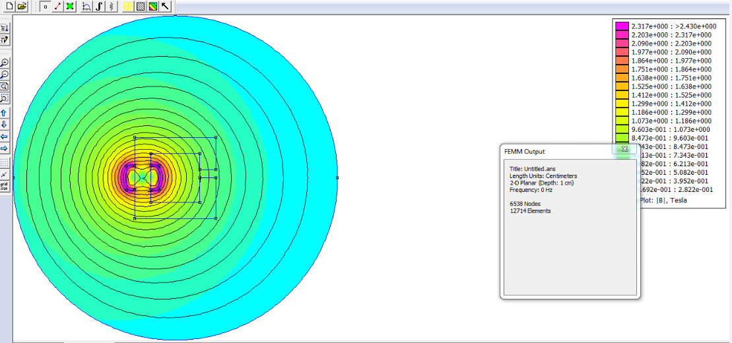

Slide 6
34 AWG copper 90000 Turns

Slide 7
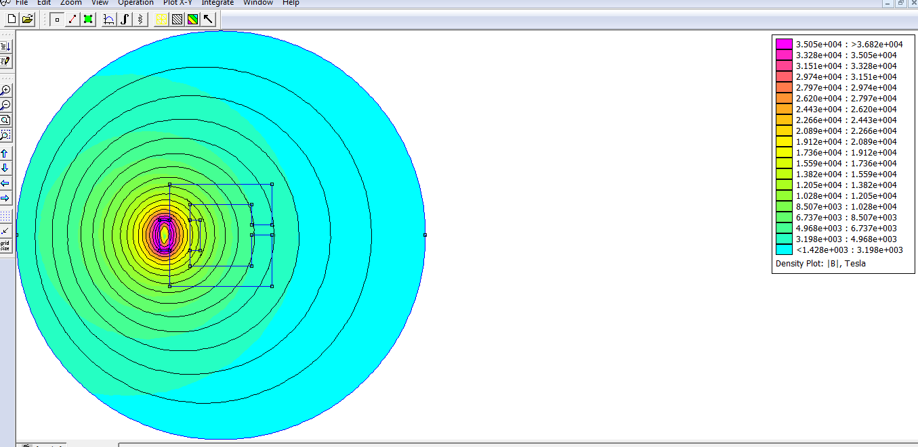

Slide 8
